Slide 1

CSCI 132: Basic Data Structures and Algorithms
Lecture 1: Syllabus, and Logistics
Reese Pearsall
Spring 2023
https://www.cs.montana.edu/pearsall/classes/spring2023/132/main.html

Slide 2
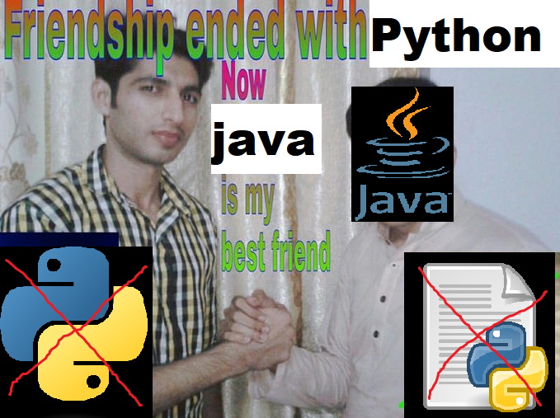
Our Goals for this Semester
Code (a lot)
Learn a new programming language (Java)
Explore the endless possibilities of
Object-Oriented Programming (OOP)
Learn a variety of Data Structures that we can use in our programs
Learn a variety of algorithms for searching and sorting
Analyze the complexity and runtime of the algorithms that we write

Slide 3
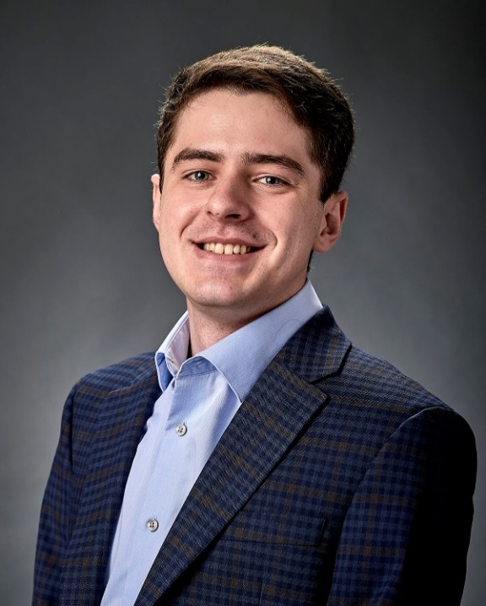
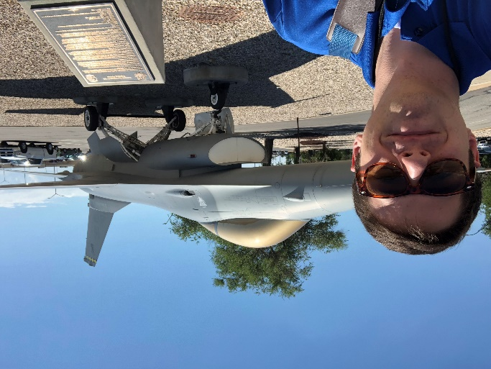

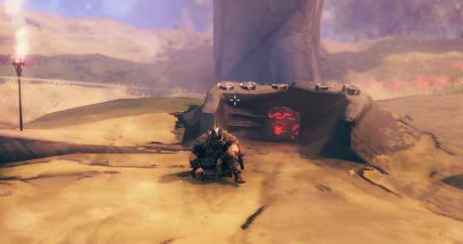
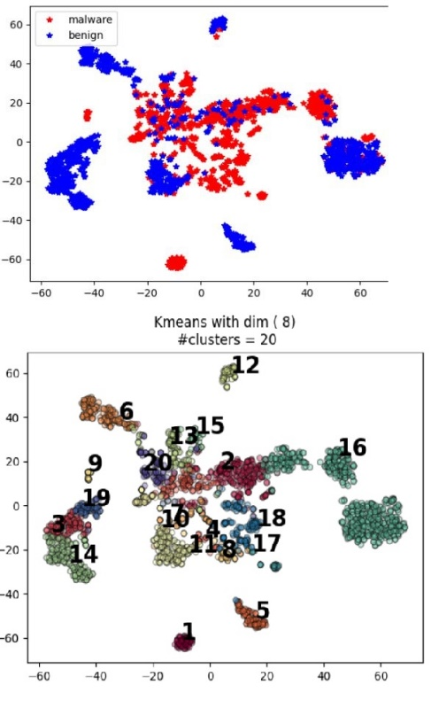

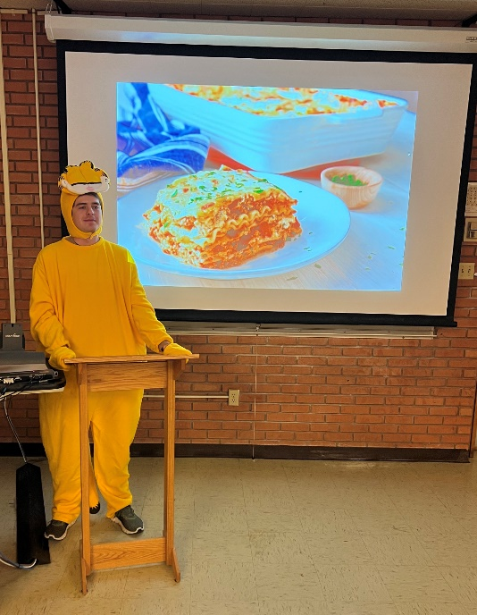
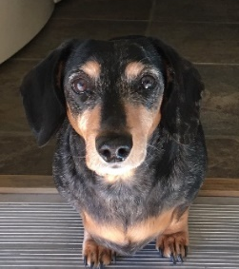
Reese Pearsall
(pierce-all)
First year Instructor @MSU
B.S & M.S @ MSU
Hometown
Billings, MT
Interests
Cybersecurity
Malware analysis and detection
Cybercrime
Computer Science Education
Teaching
CSCI 132
CSCI 476
Favorite Ice Cream
Neapolitan & Strawberry
Experience
Software Engineer and Tester, Techlink (Bozeman)
Software Engineer, United States Air Force (Hill AFB, Utah)
Software Engineer, Hoplite Industries (Bozeman)
Graduate Researcher, MSU (Bozeman)
Outside of academia
Video games, New England Patriots, Fantasy Football, TikTok, Movies, Memes,The Bachelor, Naps

Slide 4
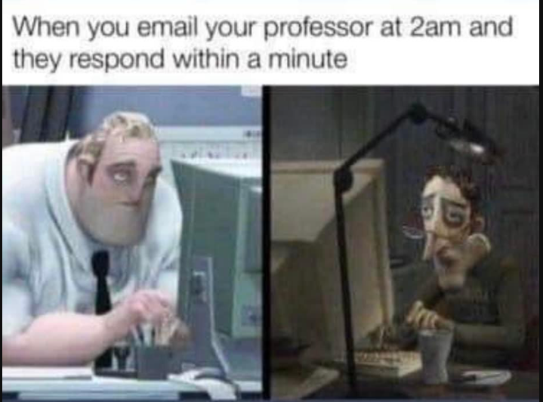
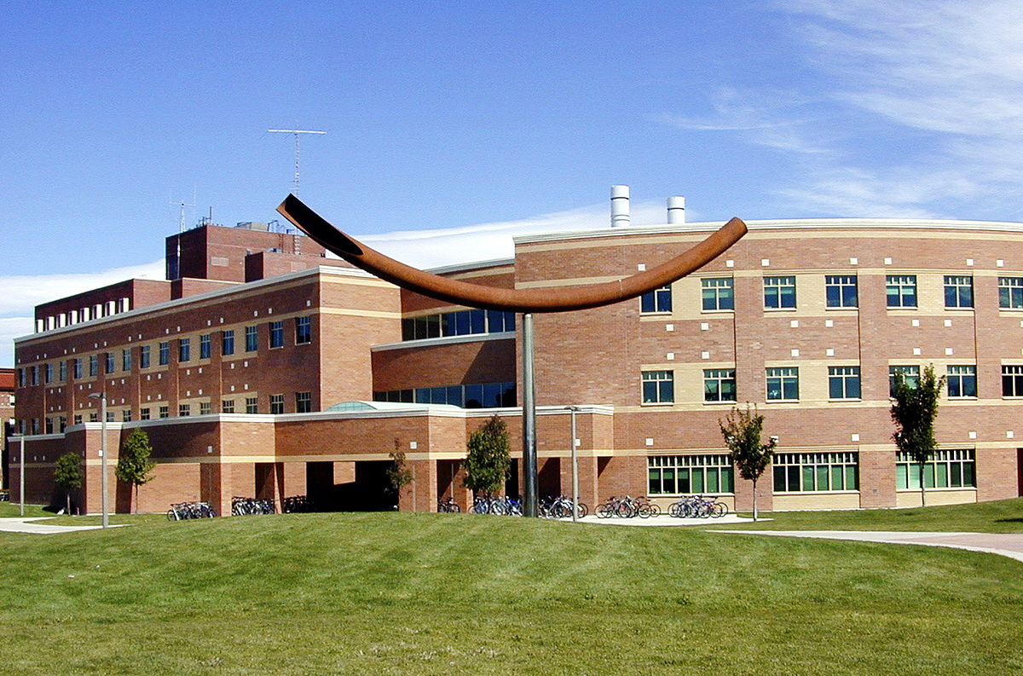
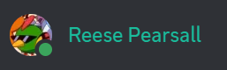

Contact
Email: reese.pearsall@montana.edu (I will respond as soon as I can)
Office Hours: Monday Wednesday Friday 1:00 – 2:00 PM
Tuesdays 11:00 – 11:50 AM, 1:00 – 2:00 PM
Office: Barnard Hall 361
I am also very responsive on Discord!
(Reese#7171)

Slide 5
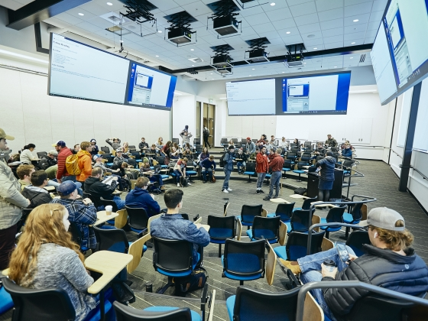
Course Logistics (Lecture)
Class Meetings
MWF: 3:10 – 4:00 PM
Norm Asbjornson Hall 165
All lectures will be recorded
We will be doing lots of live coding during lecture, so it might be helpful if you bring your own laptop to class (if you would like to code along)
Please be respectful and considerate of your classmates siting around you

Slide 6
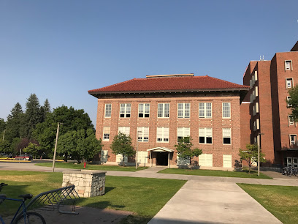

Course Logistics (Lab)
Section 002- Tuesdays 8:00 - 9:50 AM
Section 003- Tuesdays 10:00 - 11:50 AM
Section 004- Tuesdays 12:00 - 2:00 PM
Section 005- Tuesdays 2:10 - 4:00 PM
Section 006- Tuesdays 4:10 - 6:00 PM
Locations: Roberts 111
You can go to lab and get help from your TA and lab assistants
You should go to lab, but I will never track attendance
Lab assignments will be posted a few days before Tuesdays and can be completed from home.
Please try to attend the lab section that you registered for, but if you need to attend another lab section for a legitimate reason, that is fine

Slide 7
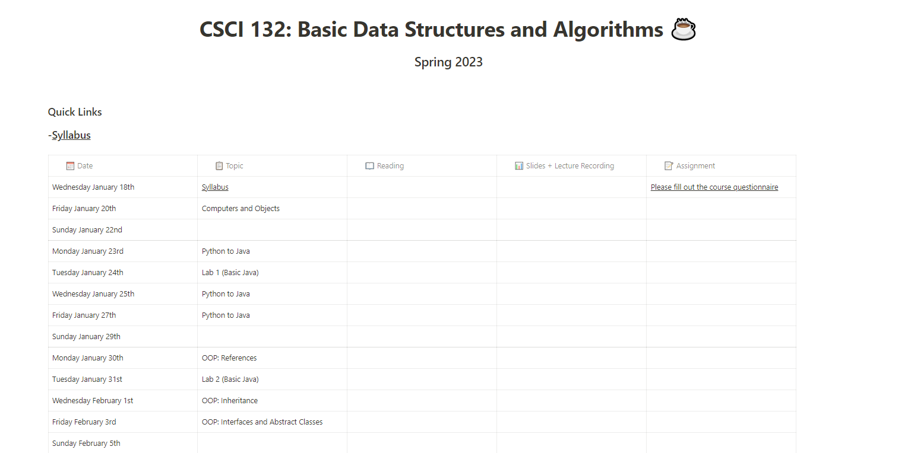
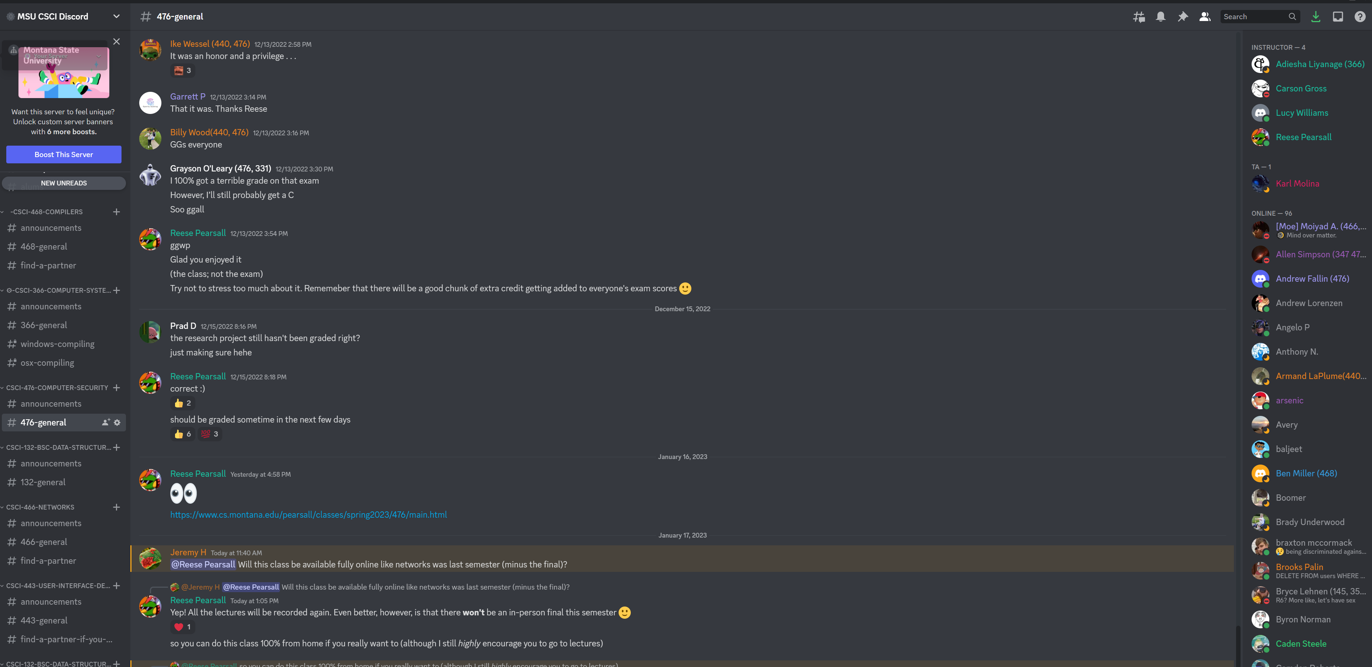
Course Logistics
You will be visiting this website a lot… be sure to bookmark it!
https://www.cs.montana.edu/pearsall/classes/spring2023/132/main.html
You also will need to join our discord server!

Slide 8
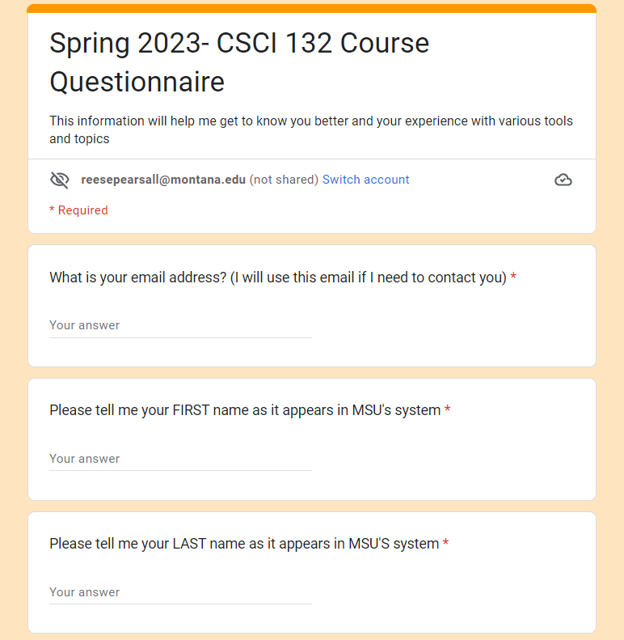
Course Questionnaire
Please take some time this week to fill out the course questionnaire ☺

Slide 9
Prerequisites
CSCI 127- Joy and Beauty of Data
M151Q- Precalculus*
*(you will be fine if you have not completed M151Q)
You should feel comfortable with basic programming constructs:
(functions, variables, loops, if statements, lists, etc)

Slide 10
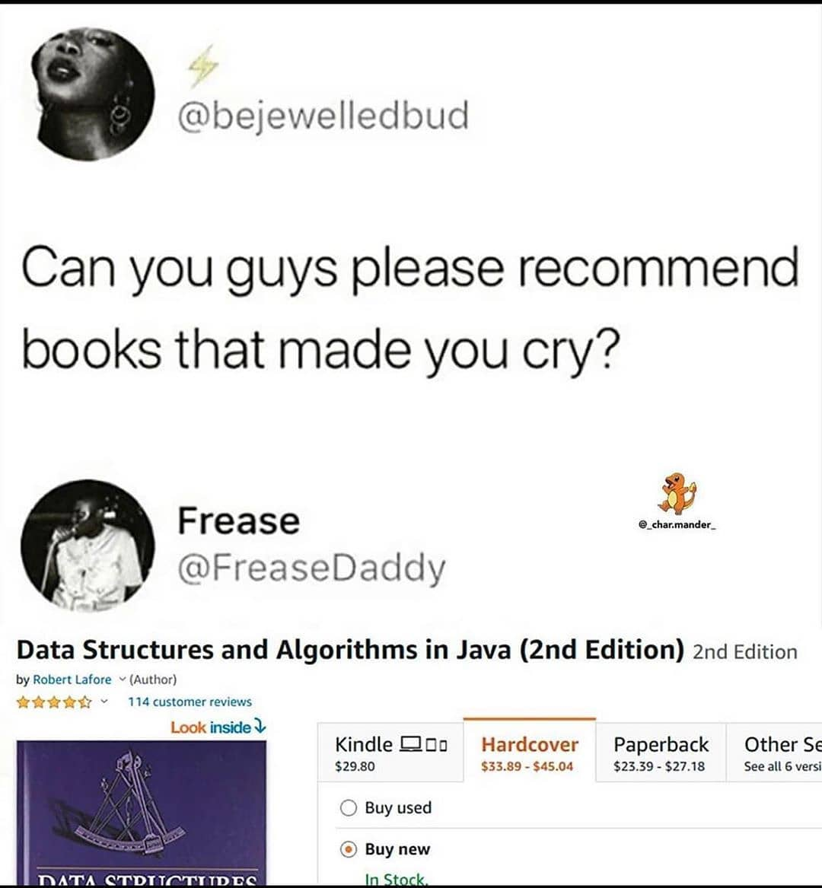
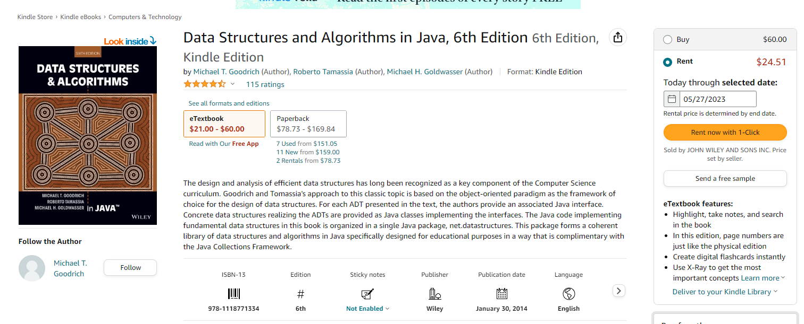
Textbook
Data Structures and Algorithms in Java, 6th Edition by Goodrich, Tamassia, and Goldwasser
unfortunately, a very relatable meme
This textbook is not required
(but it does have tons of great stuff!!)

Slide 11
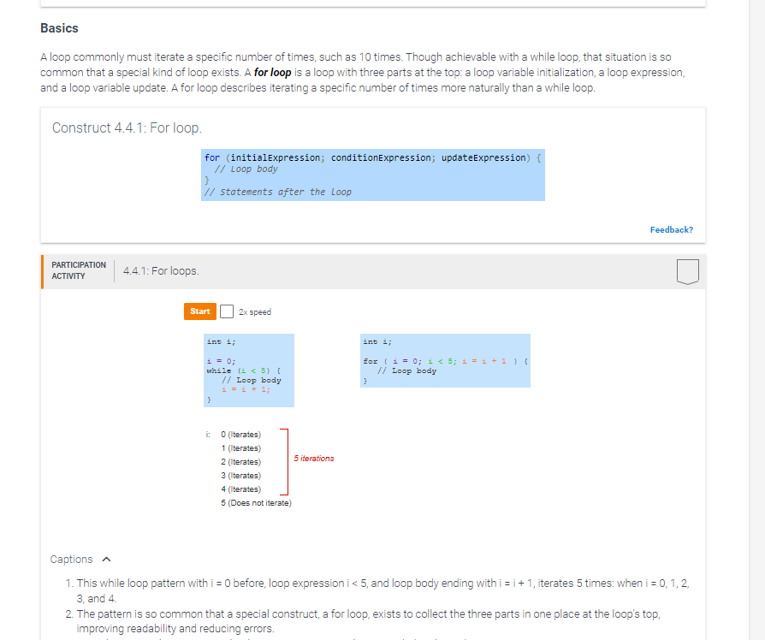
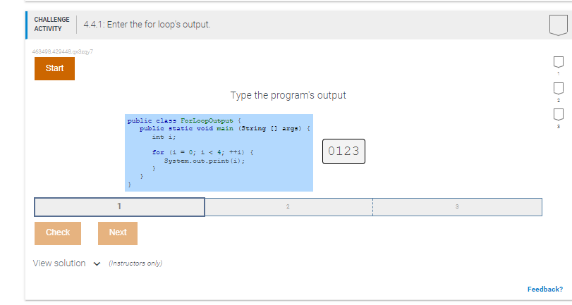
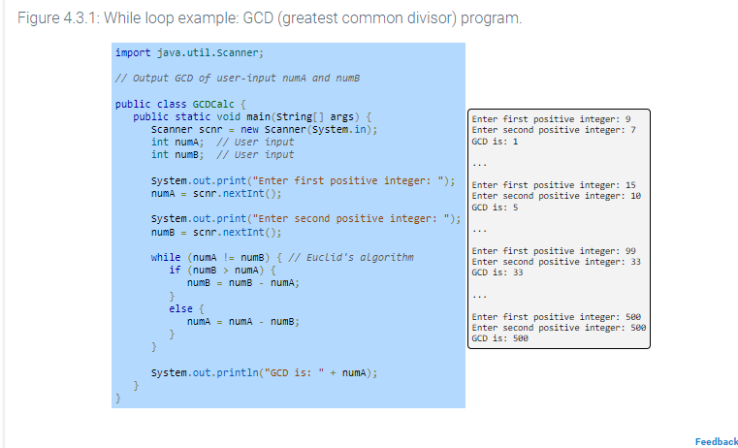
Textbook
Zybook is a digital, interactive textbook
Integrated Java Editor
Helpful exercises and examples
Helpful animations
1. Sign in or create an account at learn.zybooks.com
2. Enter zyBook code: MontanaStateUniviersityCSCI132Spring2023
3. Subscribe ($58)
This textbook is not required
(but it has the reese stamp of approval™)

Slide 12
Grading
40% - Labs (12 @ ~3% each)
40% - Programs
10% - Midterm
10% - Final Exam

Slide 13
Grading
Labs (40%)
Shorter, weekly assignments.
Can generally be finished within 1-2.5 hours
Due on Tuesday nights @ 11:59 PM
I will post the labs a few days ahead of time
You should be able to finish within your 2hr lab time
I will drop your lowest lab grade at the end of the semester
Individual submissions

Slide 14
Grading
Programs (40%)
Longer, more complicated programming assignments
Will likely take 2+ hours to complete
You will always have 2-3 weeks to complete them
Programs will usually be due on a Sunday at 11:59 PM
Much higher stakes, make sure you give yourself plenty of time to complete them
You can get help from your TA during lab time, or office hours, or from Reese, or on Discord
You are allowed to work with 1 partner

Slide 15
Grading
Exams (Midterm and Final) (20%)
Midterm: the Wednesday before spring break
Final: during finals week
The exact logistics are TBD (I don’t know if it will be entirely coding, or conceptual questions)
I will figure that out and make it very clear what you can expect on the exams beforehand ☺ (do not stress)

Slide 16

Grading
Extra Credit
Rubber Duck Extra Credit (1%)
I will give you a rubber duck to take care of during the semester
If you still have the rubber duck by the end of the semester, and if it is still alive, I will give you extra credit
There will likely be a couple other opportunities for extra credit

Slide 17
Late assignment policy
If you submit late, but you are within < 24 of the original. You will face a -25% penalty
If you submit late, but you are within < 48 of the original. You will face a -50% penalty
Any assignment submitted 48+ hours after the deadline will not be accepted

Slide 18
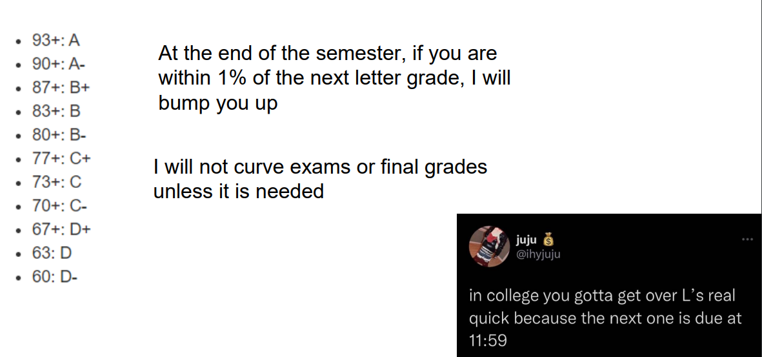
Grading Scale

Slide 19
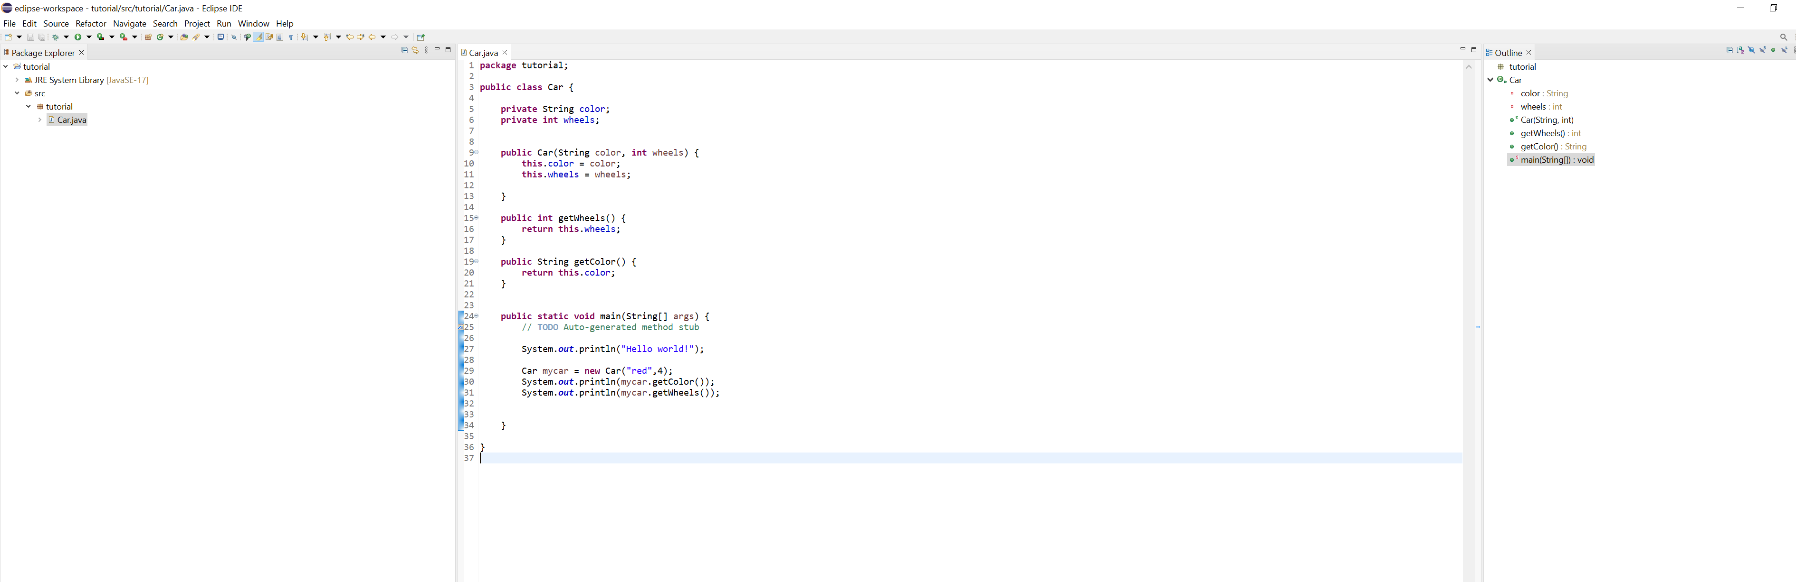
IDE
You will need to download an IDE that you can write Java programs in
Eclipse (I will use this one)
Netbeans
IntelliJ
I will post a video walking you through the installation process ☺

Slide 20
Academic Misconduct
Plagiarism and cheating is very not cool
You are not allowed to submit something that is not your own, and you are not allowed to steal solutions from another person and modify it
I have a Chegg and Course Hero membership. Don’t try it
Using small snippets of code from the internet is acceptable (but should not be needed). If you do use a small snippet of code from the internet, you should leave a reference as a comment in your code
Do not use any tools or AI that will write code for you

Slide 21
Collaboration Policy
All labs will be individual submissions.
For programs, you are allowed to work with one partner.
When it comes to labs, you may
Share ideas with other students in the class.
Work together on labs in the same physical location.
Help other students troubleshoot problems.
Give hints or provide textbook page numbers/slide numbers to students seeking help
You may NOT
Share your code and solutions directly with other students.
Submit solutions that you did not write.
Modify another student's solution and claim it as your own.
Share your report or solutions directly on Discord

Slide 22
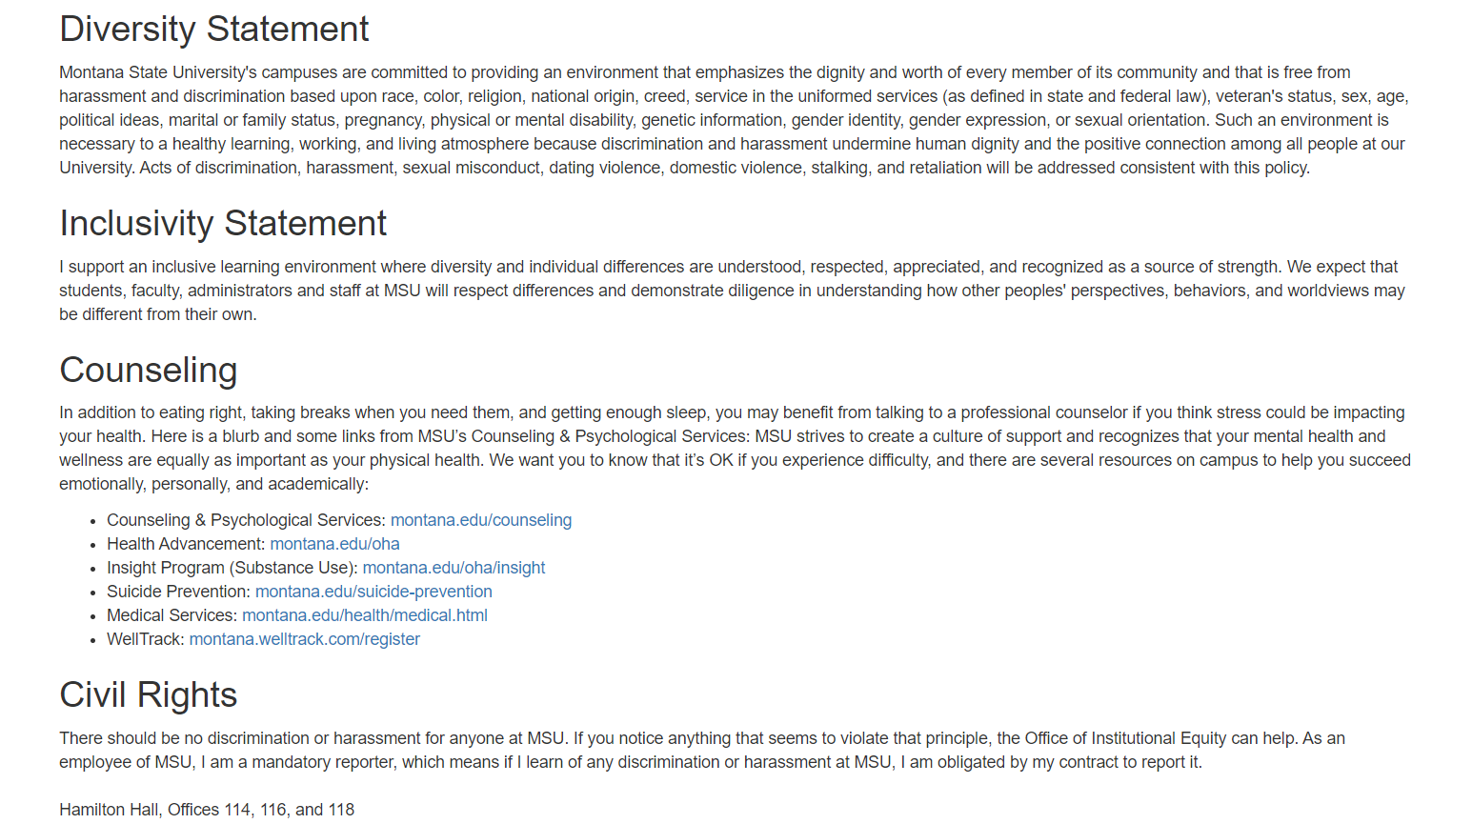
Additional MSU Resources:
https://www.cs.montana.edu/pearsall/classes/msu_resources.html

Slide 23
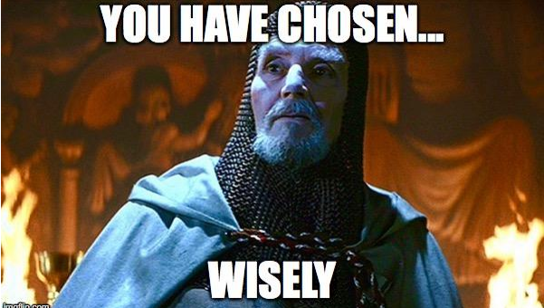
How to do well in this class
The first few weeks of this class move fast, and it can be easy to get behind.
Get help when you need it
Get started on assignments early (especially programs)!
Come to class and office hours

Slide 24

How to do well in this class
The first few weeks of this class move fast, and it can be easy to get behind.
Get help when you need it
Get started on assignments early (especially programs)!
Come to class and office hours
Try to have fun
I am here for you, and I am willing to do whatever it takes to help you succeed!

Slide 25
Questions?

